Slide 1

Lung Cancer
Detection Model Using Convolution
Neural Networks LCD – CNN Model
Students' Work:
OMAR AHMED , MUHAMMAD HARARA, MAHMOUD ABU AISHA , ISA ABU SALMIYA

Slide 2
Table contents :
1
Research Problem
2
Objectives
3
Proposed Model
Previous Studies
4
5
Evaluation
Future Work
6

Slide 3
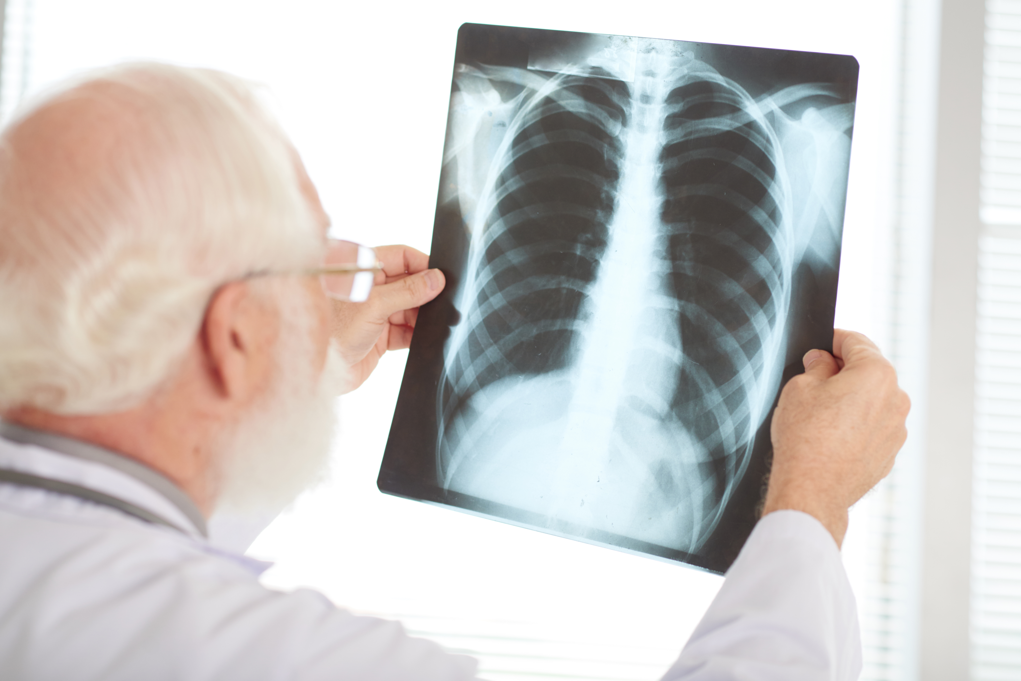
Research Problem
In general there are medical errors in detecting the lung cancer, and there is also a low of accuracy where the possibility of obtaining correct results for the presence or absence of lung cancer is not the required ratio, and also it was noted that Previous models need time in processing images to get the result .

Slide 4

Objectives
1) Identify the problems in the current cancer detection models.
2) To build a model based on CNN using to detect lung cancer.
3) To evaluate the proposed model using chest CT scan images Dataset.

Slide 5
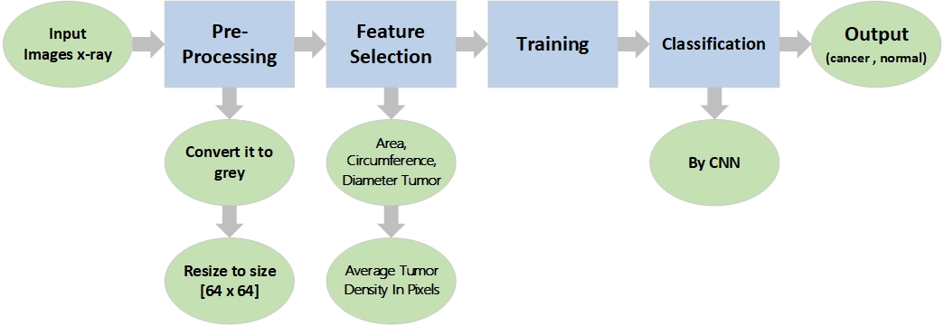
Proposed Model :

Slide 6
Dataset Model :
Chest CT-Scan Images Dataset
3,439 images with the extension .png
Images type x-ray
images classified as normal people: 821
images classified as cancer patients: 2618

Slide 7
Evaluation
Accuracy | Algorithm | ID
74.43 % | Deep Learning Approach | [1]
60.1 % | Subtraction method between two serial mass chest radiographs is proposed. | [2]
84 % | Deep Learning | [3]
95 % | (Deep Learning) using deep learning-based surface-enhanced Raman spectroscopy (SERS) of the exosomes. | [4]
60 % | Artificial Neural Network (ANN) | [5]
92.61 % | Artificial Neural Network | [6]
84.6 % | support vector machine (SVM) | [7]
85 % | Lung cancer detection using biomarkers | [8]
95 % | ANN | [9]
98 % | LCD – CNN Model | [10]

Slide 9
Future Work
Future Work :
1) Discover whether cancer is benign or malignant .
2) Support images in any extension .
3) 3D photo support .
4) Color photo support .
5) Locating the cancer in the lung .
6) Embedded system with a website .

Slide 10

Thanks

